Slide 1
Lecture 2
Species Concentrations, the mixture fraction
and the adiabatic flame temperature
2.-1

Slide 2
Combustion
- mass and energy conversion process
- chemical bond energy → thermal energy
Fuel reacts with the oxygen of the air
→ products (mainly carbon dioxide and water) with
lower enthalpy of formation or reference enthalpy
than the reactants
2.-2

Slide 3
The final state of a homogeneous system is governed by the
classical balance laws of thermodynamics.
Prerequisites:
- definitions of concentrations and thermodynamic variables
- mass and energy balance for multicomponent systems
2.-3

Slide 4
Mole Fractions and Mass Fractions
In chemical reactions chemical elements are conserved.
For example:
the particular atom defining the element C within a CH₄ molecule will be found within the CO₂ molecule if combustion is completed.
In order to describe the chemical transformation between species quantitatively, we need to introduce definitions for concentrations.
2.-4

Slide 5
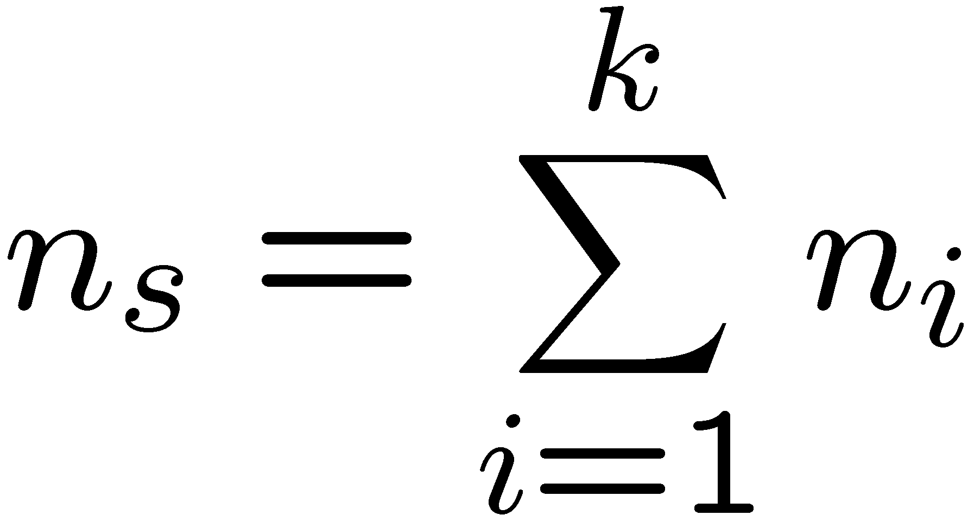
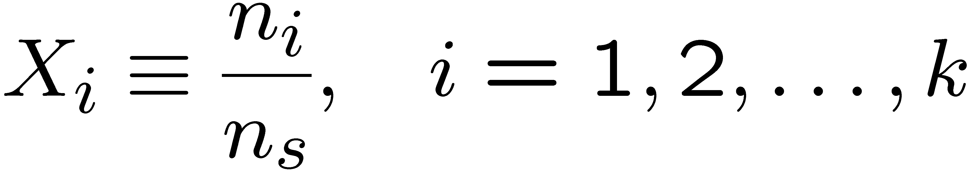
The Mole Fraction
Multi-component system with k different chemical species
Mole: 6.0236 10²³ molecules are defined as one mole.
Number of moles of species i: n_{i}
Total number of moles:
Mole fraction of species i:
2.-5

Slide 6
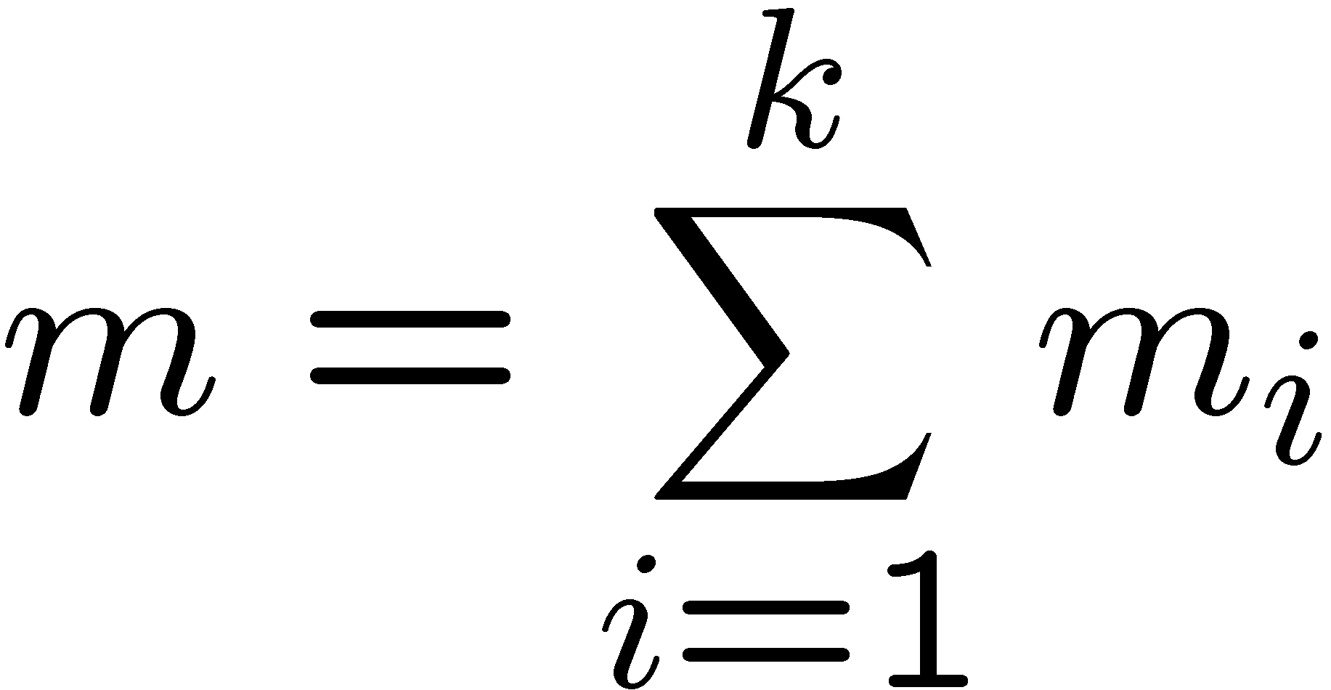
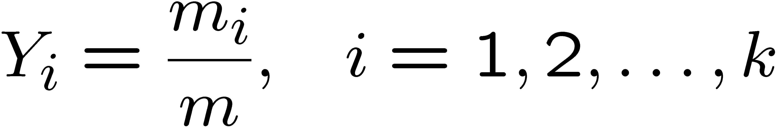

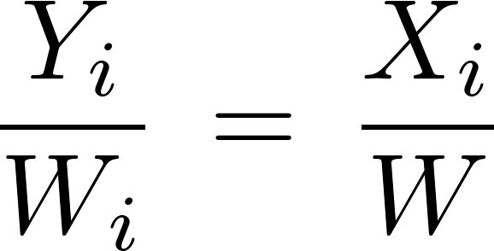
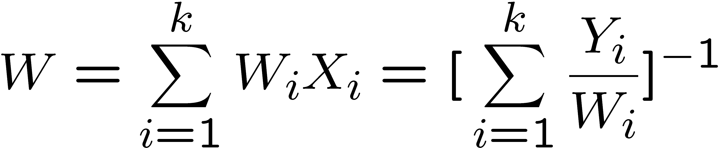
The Mass Fraction
Mass m_{i} of all molecules of species i is related to its number of moles by
where W_{i} is the molecular mass of species i.
Total mass of all molecules in the mixture:
Mass fraction of species i
Definition of mean molecular mass:
Relation between mole fractions and mass fractions:
Mean molecular mass:
2.-6

Slide 7
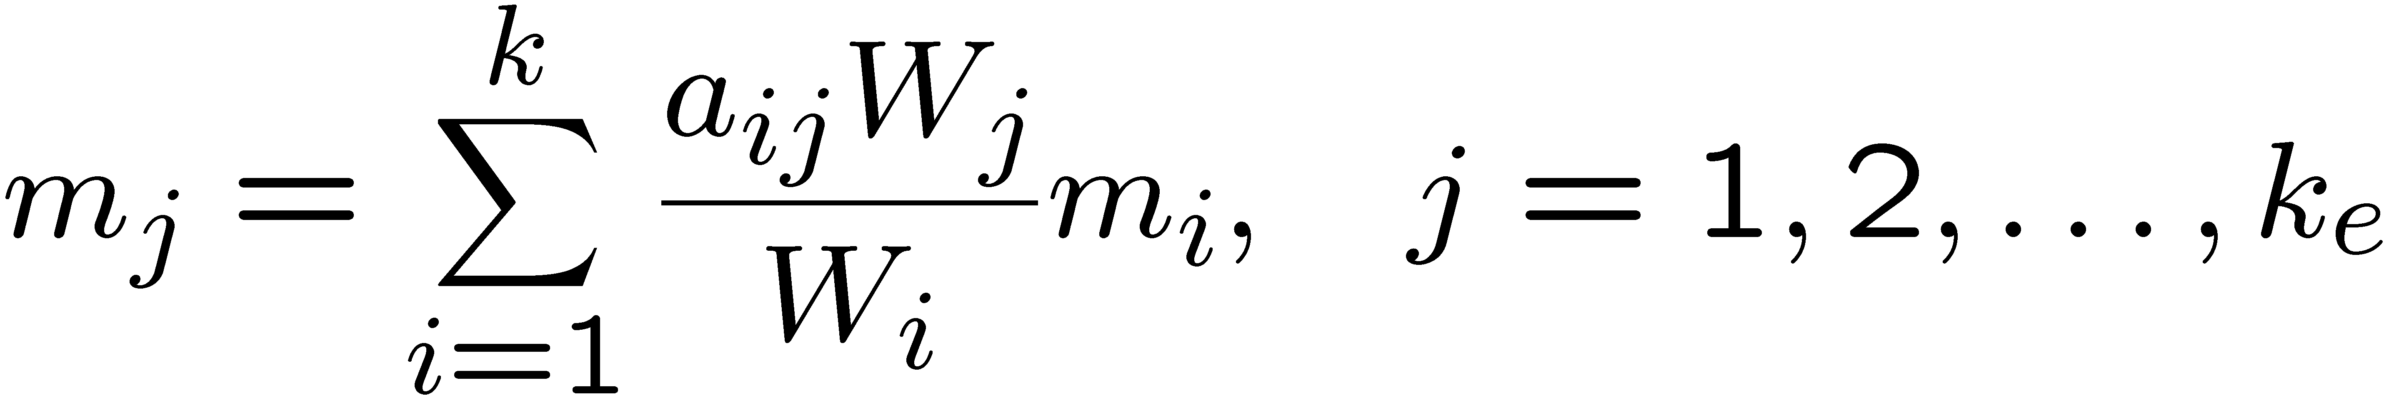
The mass fraction of elements
The mass fraction of elements is very useful in combustion.
Mass of the species changes due to chemical reactions,
the mass of the elements is conserved.
Mass and molecular weight of all atoms of element j contained in all molecules: m_{j} , W_{j}
Number of atoms of element j in a molecule of species i : a_{ij}
Mass of all atoms j in the system:
where k_{e} is the total number of elements in the system.
Notice that no meaningful definition for the mole fraction of elements can be given because only the mass of the elements is conserved.
2.-7

Slide 8
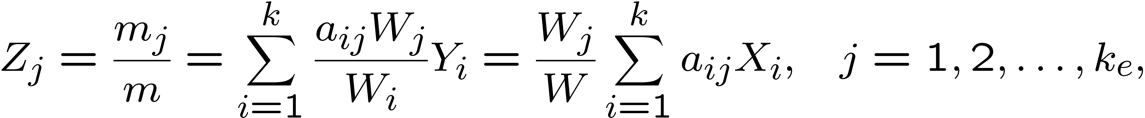
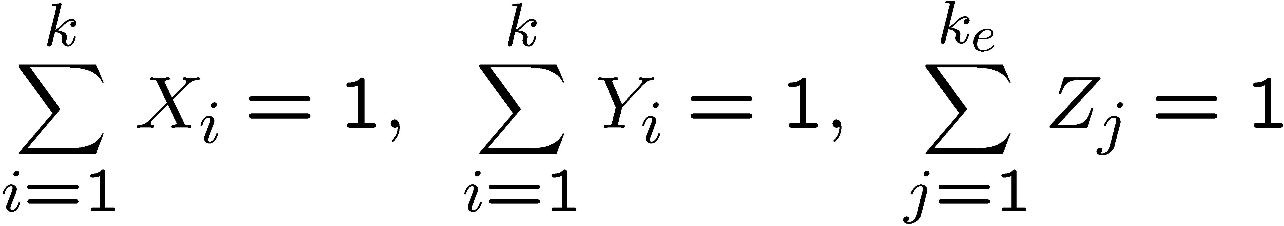
The mass fraction of element j is then
From the definitions above it follows
2.-8

Slide 9
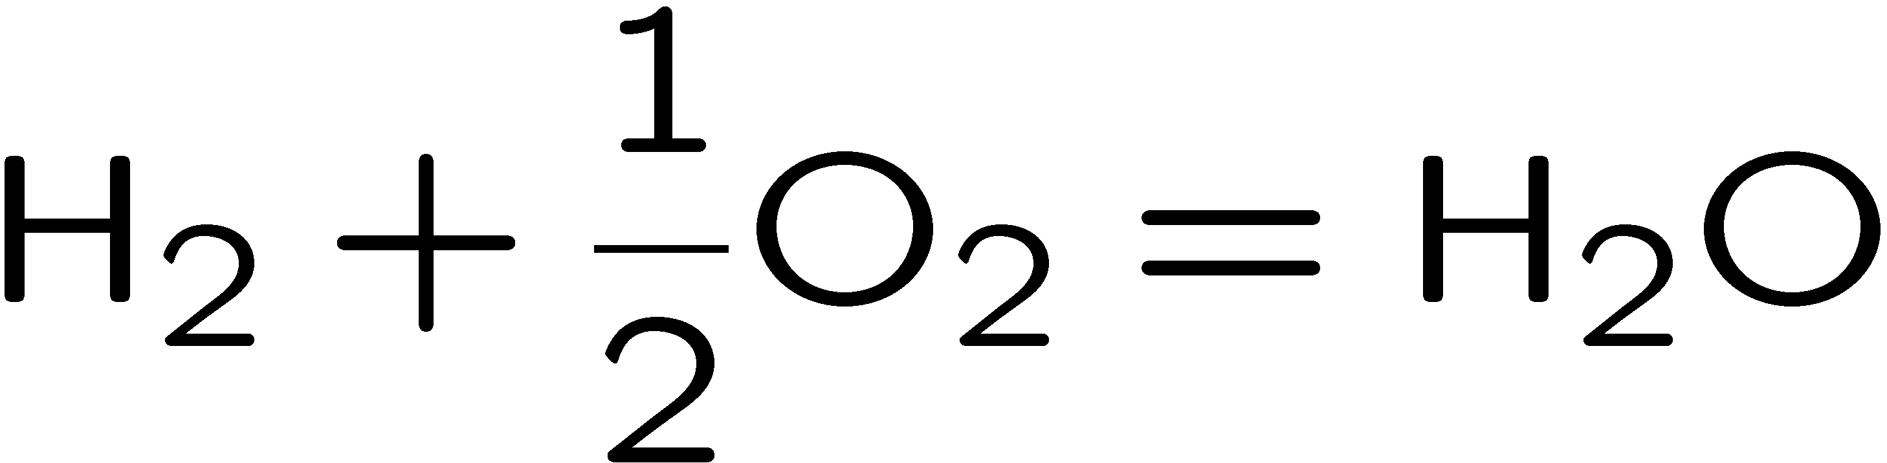
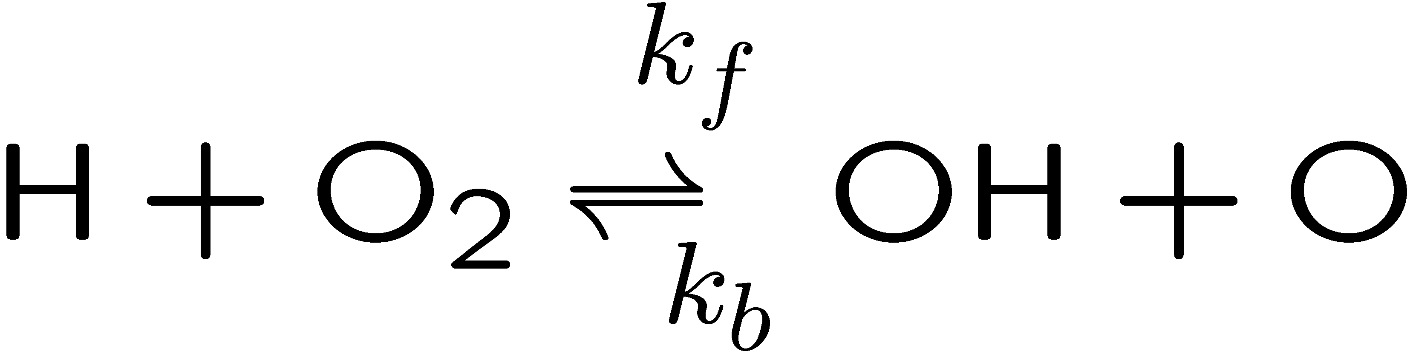


Stoichiometry
Equations describing chemical reactions
Global reactions like
or elementary reactions like
are based on the principle of element conservation during reaction.
The stoichiometric coefficients of the reactant i:
The stoichiometric coefficients of the product i:
2.-9

Slide 10
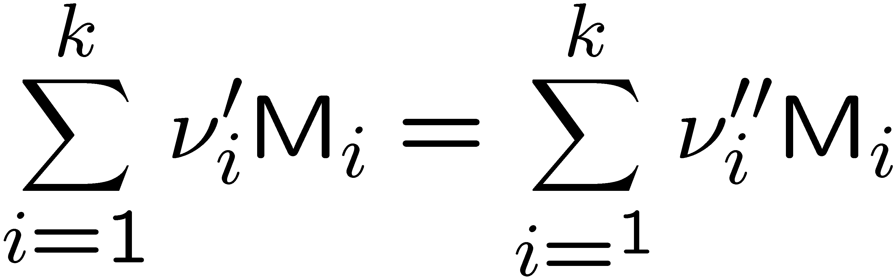
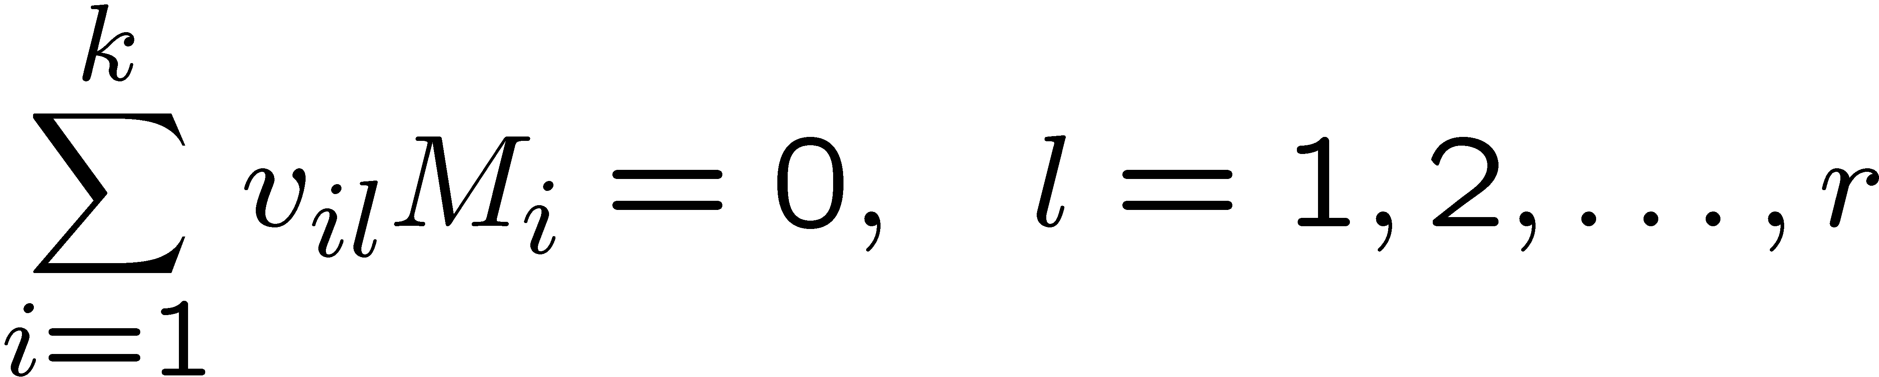

If M_{i} stands for the chemical symbol of species i a reaction equation may be cast into the form
Net stoichiometric coefficient
is positive for products and negative for reactants.
A system of r elementary reactions may be written
where the net stoichiometric coefficient of species i in reaction l is:
2.-10

Slide 11
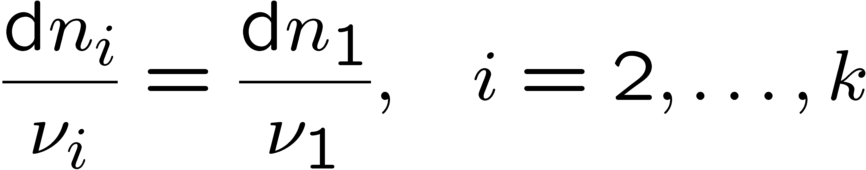
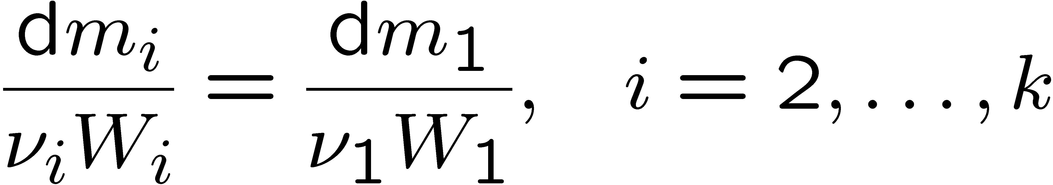
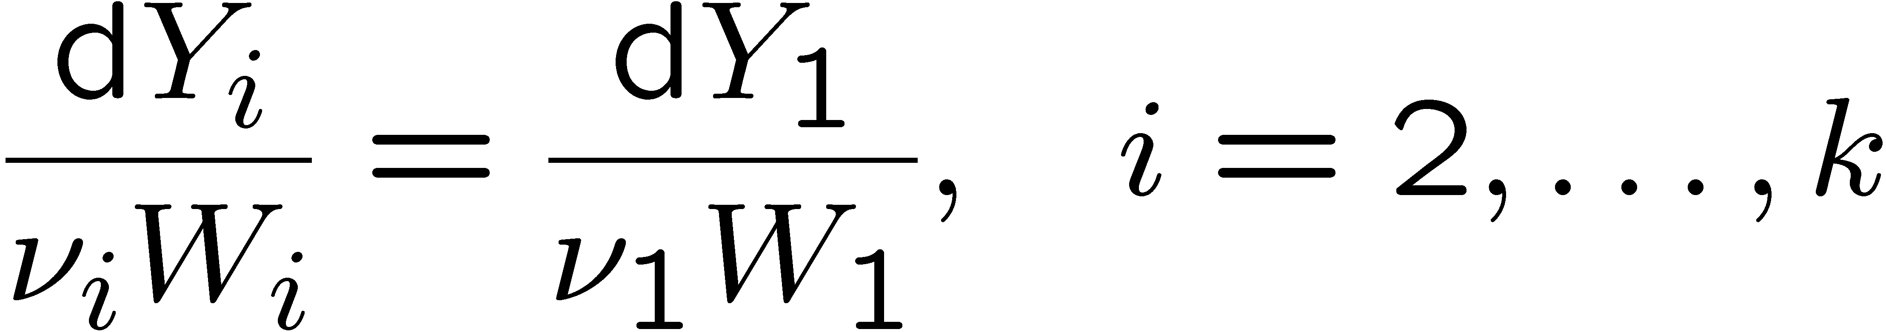
The stoichiometry defined by the reaction equation relates the molar production or consumption of species to each other.
The change of the number of moles of species i to that of species 1 is
The relation between the partial masses is
Since the total mass in the system is independent of the chemical reaction
(while the total number of moles is not), the relation between mass fractions is
2.-11

Slide 12
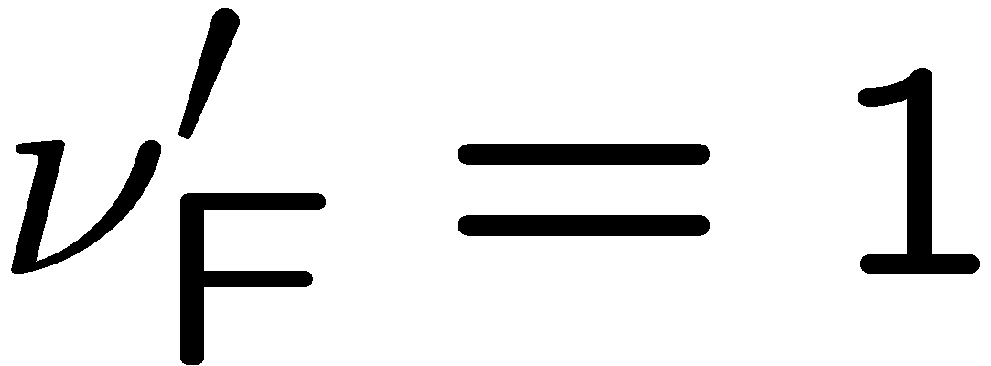
A fuel-air mixture is called stoichiometric, if the fuel-to-oxygen ratio is such that both are entirely consumed when combustion to CO₂ and H₂O is completed.
For example, the global reaction describing the combustion of a single component hydrocarbon fuel C_{m}H_{n} (subscript F for fuel)
the stoichiometric coefficients are
where may be chosen arbitrarily to unity.
2.-12

Slide 13
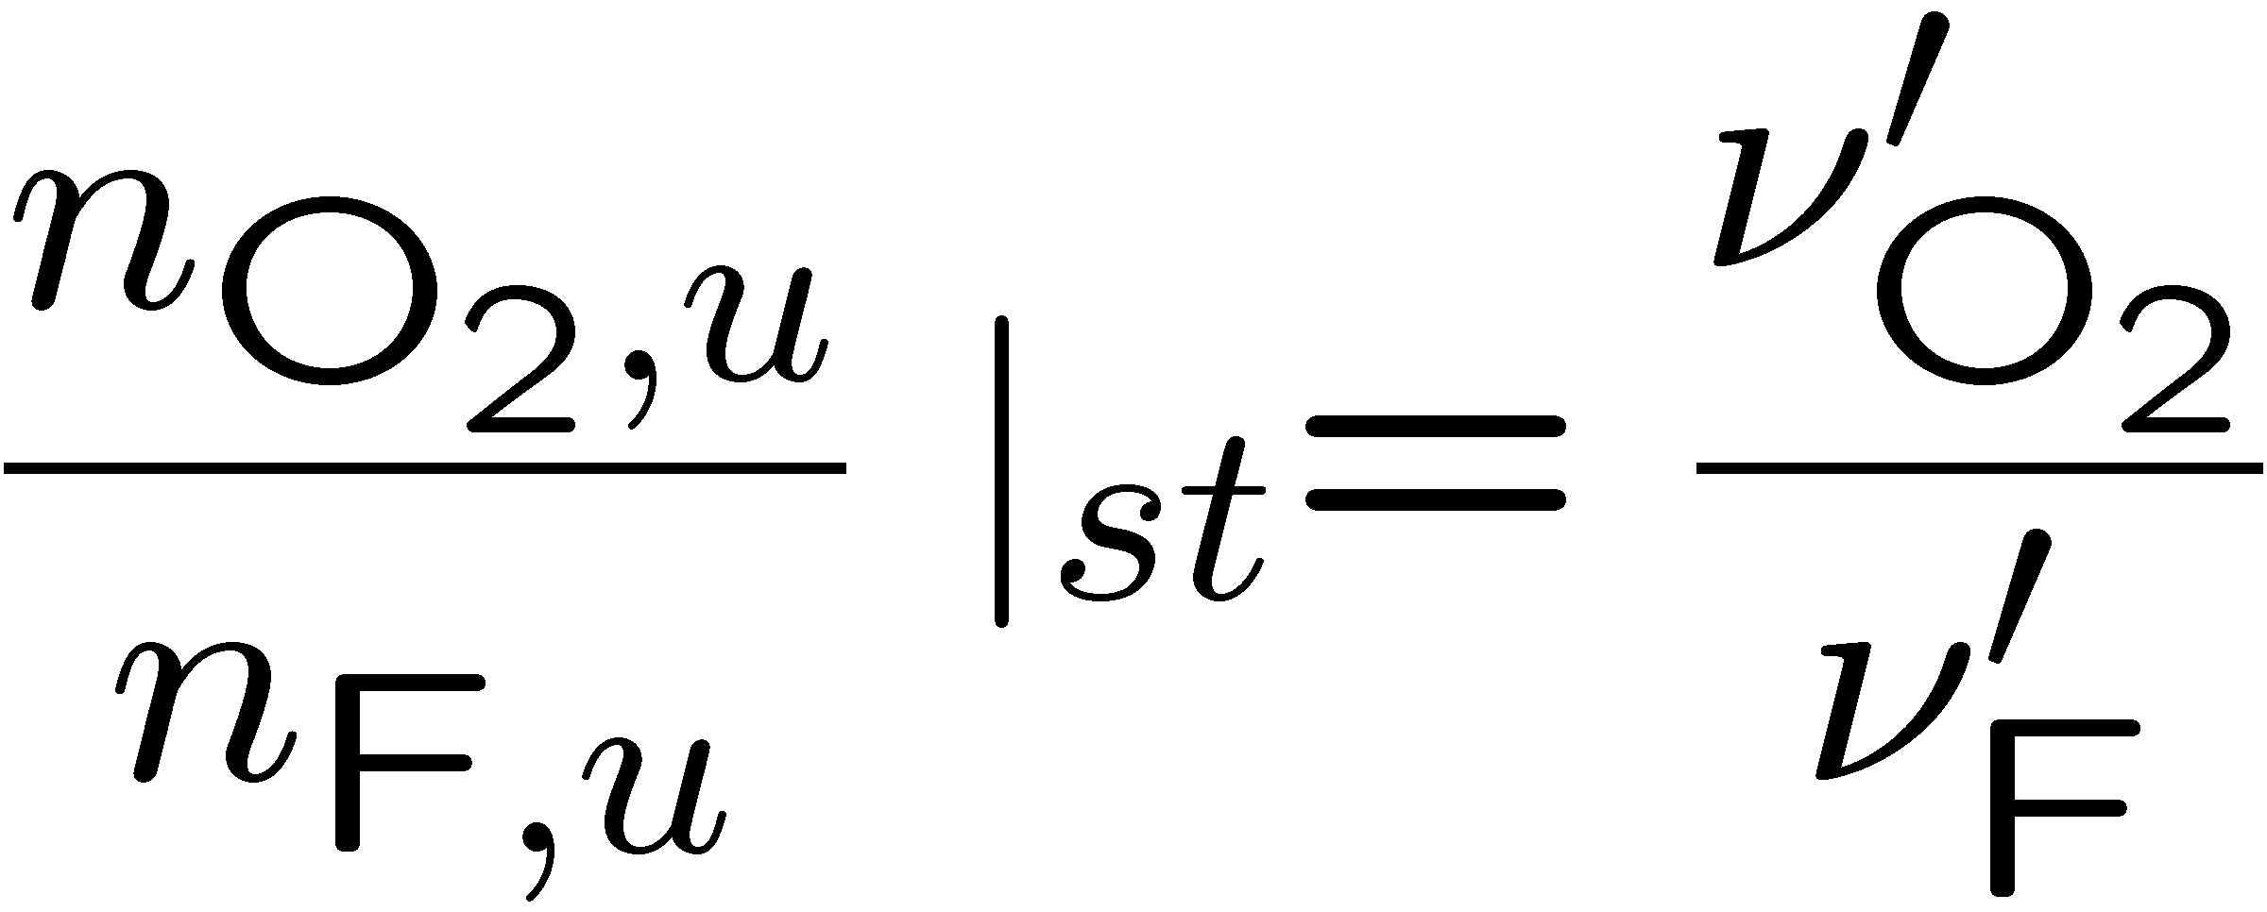
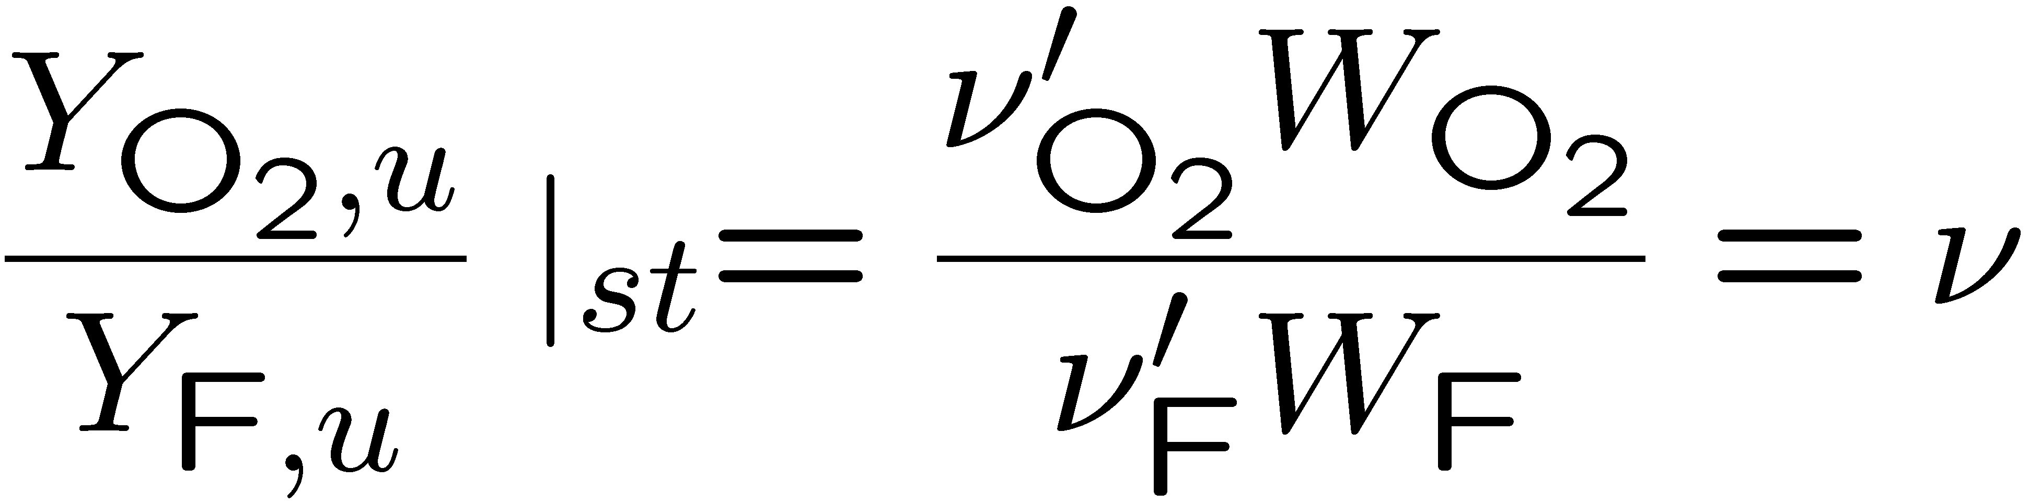
Stoichiometric mixture requires that the
ratio of the number of moles of fuel and oxidizer in the unburnt mixture
is equal to the
ratio of the stoichiometric coefficients
or in terms of mass fractions
where ν is called the stoichiometric mass ratio.
Then fuel and oxidizer are both consumed when combustion is completed.
2.-13

Slide 14
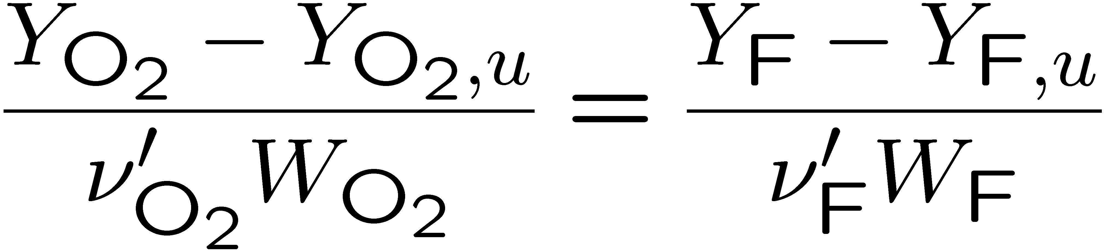
Integrating
with i = O₂, 1 = F between the initial unburnt state (subscript u) and any later state leads to
This may be written as
2.-14

Slide 15
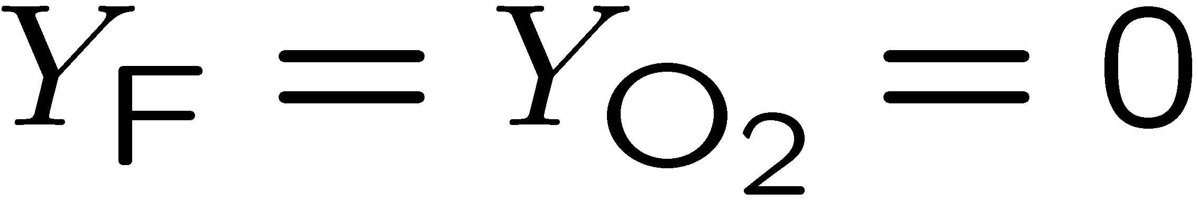
For a stoichiometric mixture fuel and oxygen are completely consumed at the end of combustion:
Introducing this into
we recover
2.-15

Slide 16
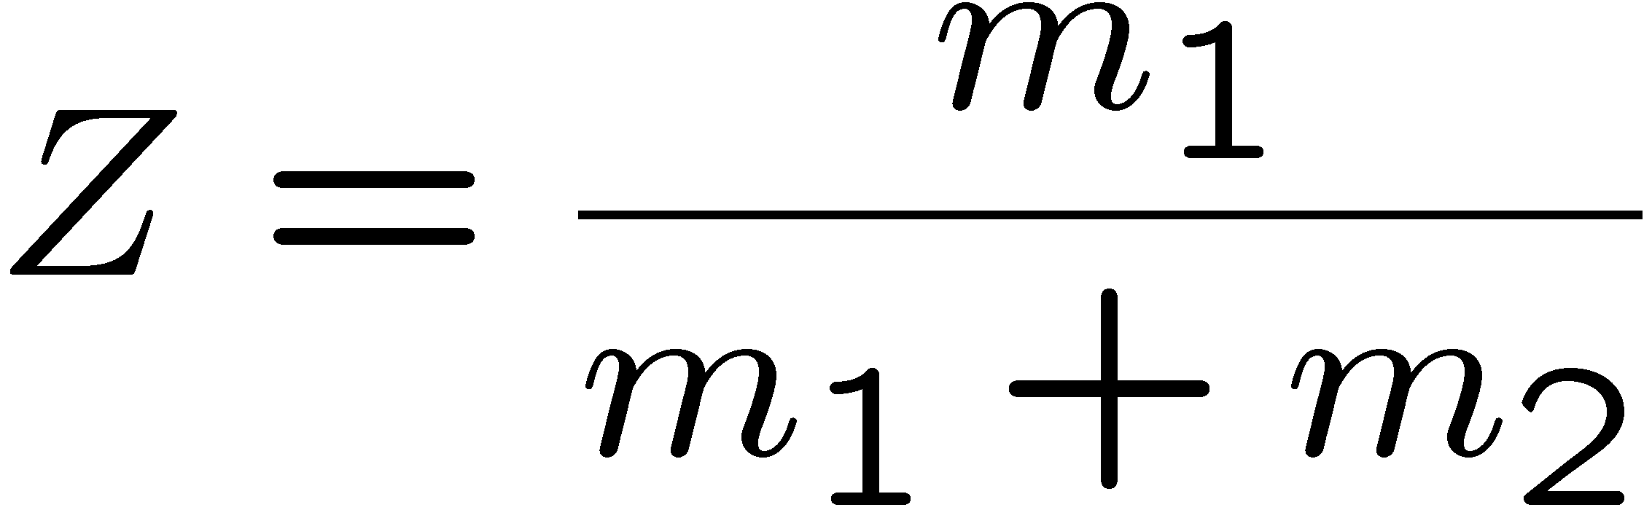
The Mixture Fraction
The mixture fraction is an extremely useful variable in combustion
in particular for diffusion flames.
Here we present it first for a homogeneous system.
In a two-feed system a fuel stream (subscript 1) with mass flux m₁ is mixed with an oxidizer stream (subscript 2) with mass flux m₂.
The mixture fraction represents the mass fraction of the fuel stream in the mixture:
Both fuel and oxidizer streams may contain inerts such as nitrogen.
2.-16

Slide 17
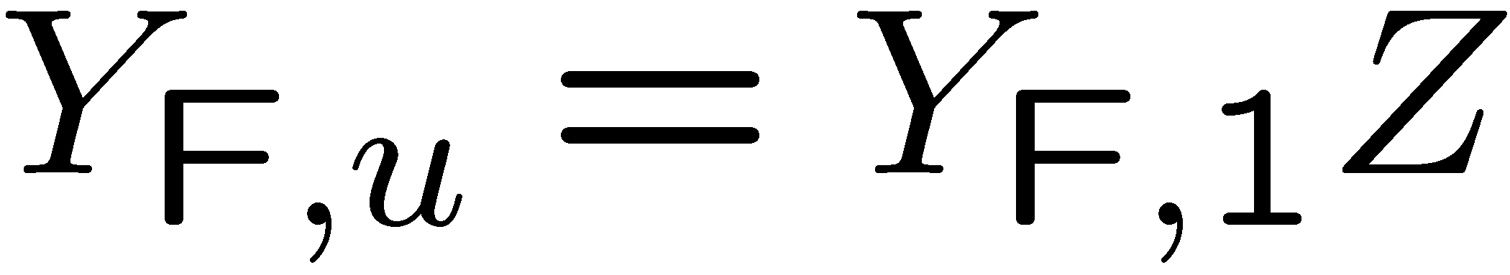
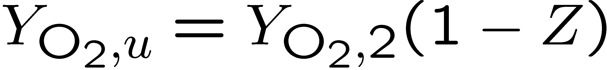
The mass fraction Y_{F,u} of the fuel in the mixture is proportional to the mass fraction in the original fuel stream, so
where Y_{F,1} denotes the mass fraction of fuel in the fuel stream.
Similarly, since 1-Z represents the mass fraction of the oxidizer stream in the mixture, one obtains for the mass fraction of oxygen in the mixture
where Y_{O2,2} represents the mass fraction of oxygen in the oxidizer stream
(Y_{O2,2} = 0.232 for air).
2.-17

Slide 18
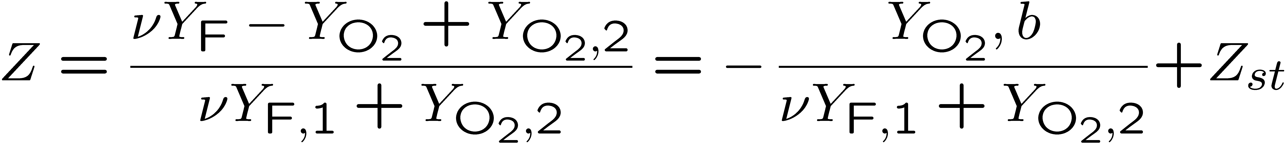
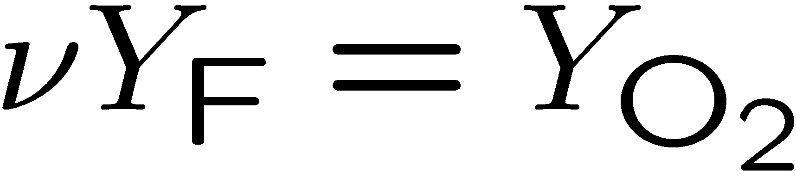
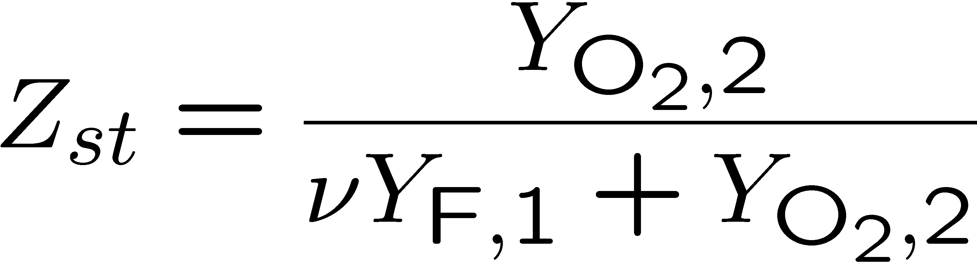
Introducing
and
into
one obtains the mixture fraction as a variable that couples the mass fractions of the fuel and the oxygen
For a stoichiometric mixture one obtains with
the stoichiometric mixture fraction
2.-18

Slide 19
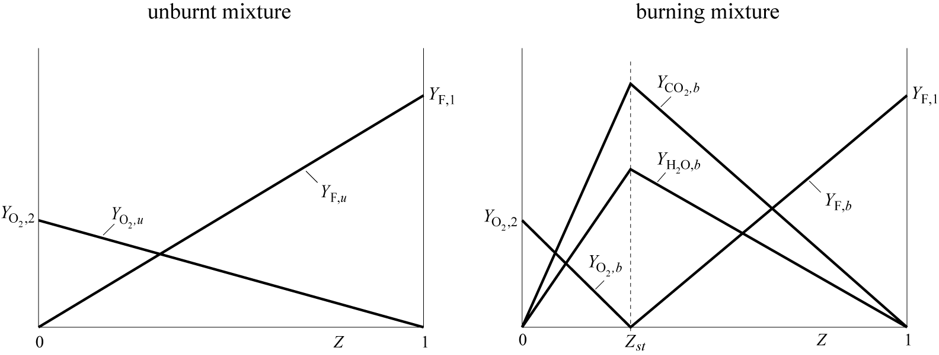
Profiles of Y_{F} and Y_{O2} in the unburnt gas
2.-19

Slide 20
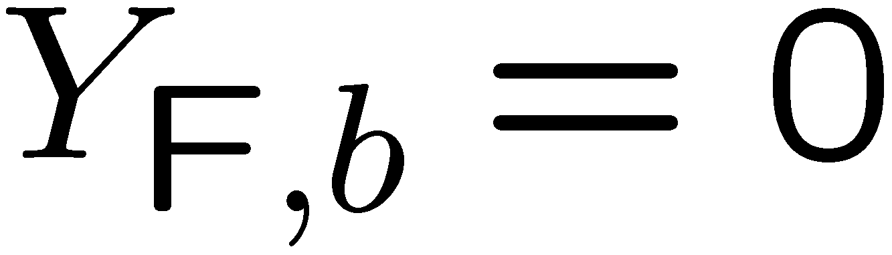
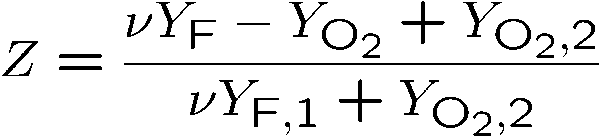
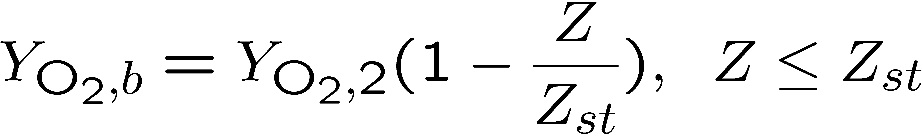
If Z < Z_{st} fuel is deficient and the mixture is called fuel lean.
Then, combustion terminates when all the fuel is consumed:
(burnt gas, subscript b).
The remaining oxygen mass fraction in the burnt gas is calculated from
as
where
was used.
2.-20

Slide 21
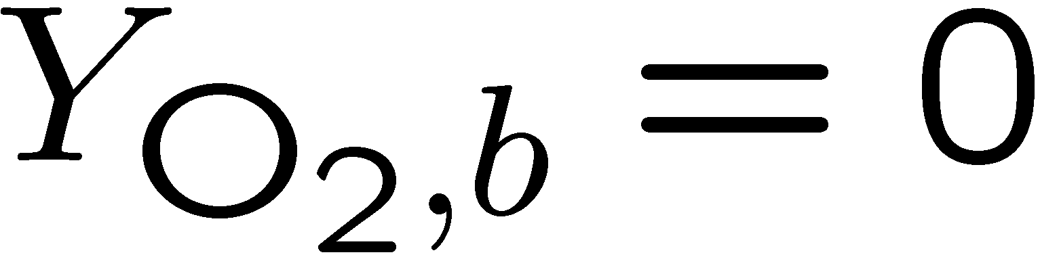
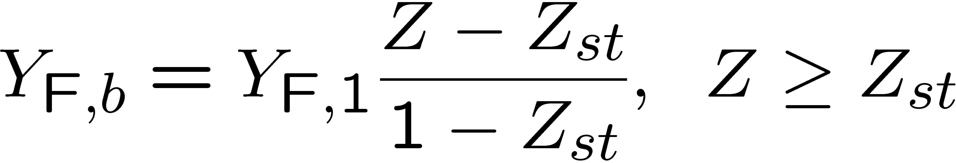
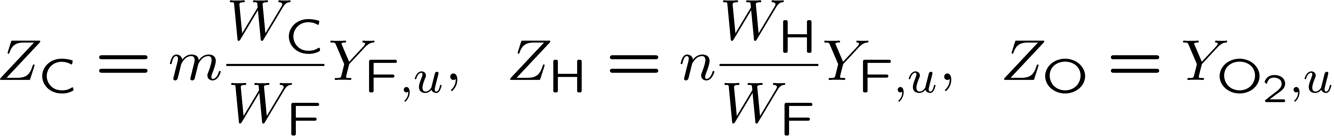
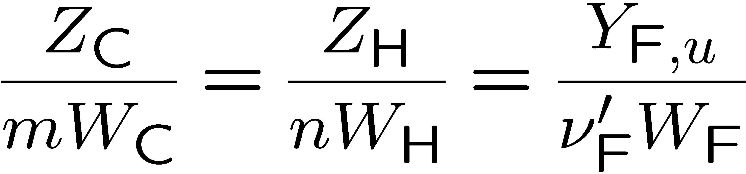
Similarly, if Z > Z_{st} oxygen is deficient and the mixture is called fuel rich.
Combustion then terminates when all the oxygen is consumed:
Leading to
For the hydrocarbon fuel considered above the element mass fractions in the unburnt mixture are
or
2.-21

Slide 22
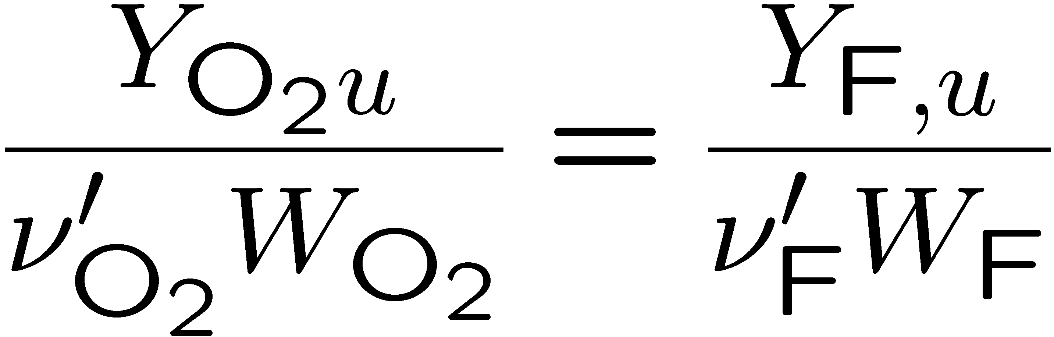
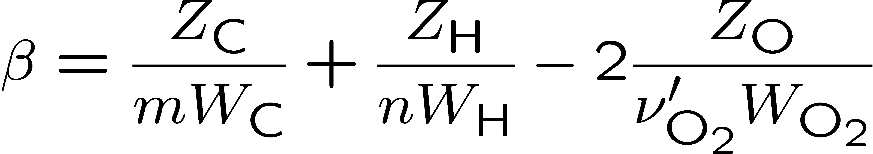
For a stoichiometric mixture where
it follows that the combination
vanishes.
2.-22

Slide 23
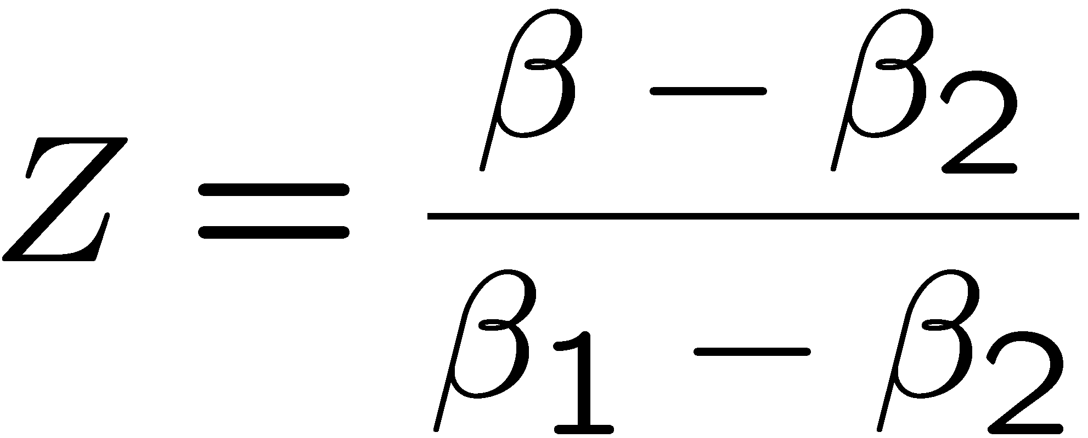
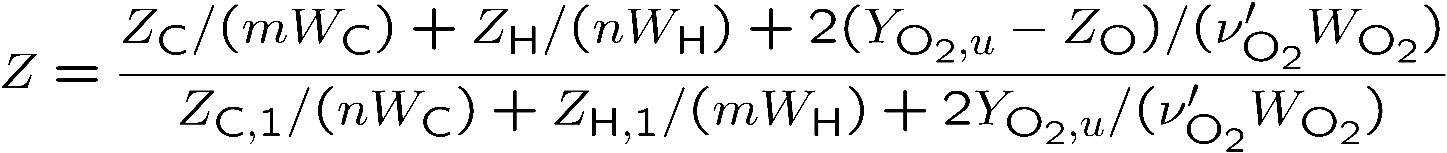
Normalizing this such that Z = 1 in the fuel stream and Z = 0 in the oxidizer stream,
one obtains Bilger's definition
or
Because elements are conserved during combustion, the element mass fractions calculated from
do not change.
2.-23

Slide 24
Profiles in the burning mixture
2.-24

Slide 25
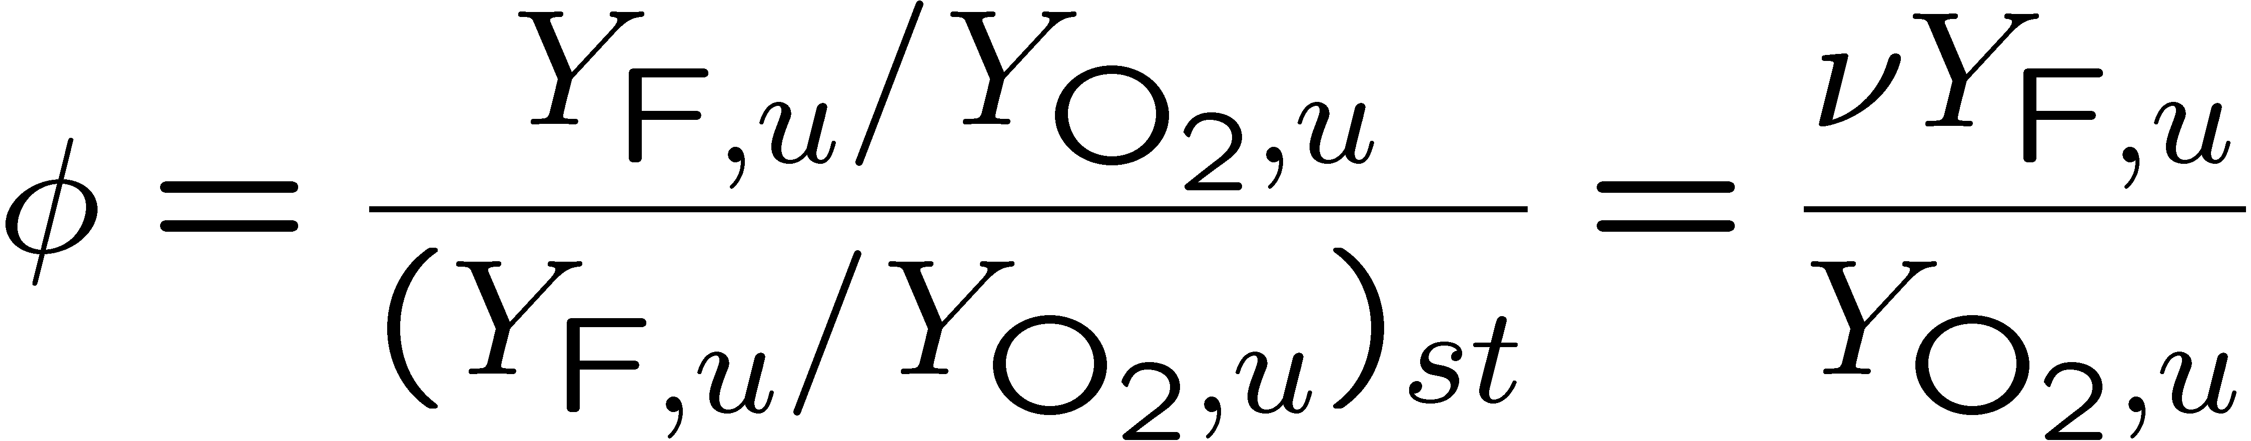
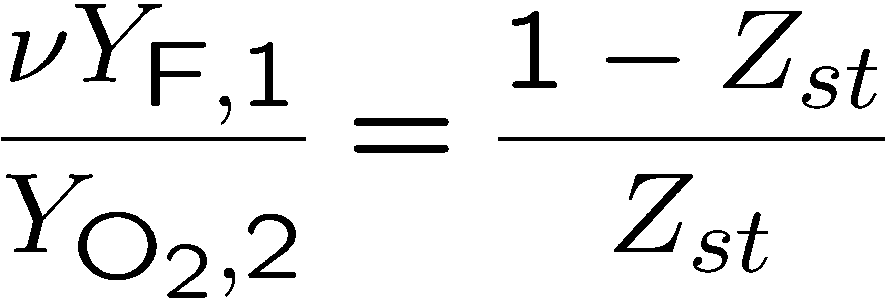
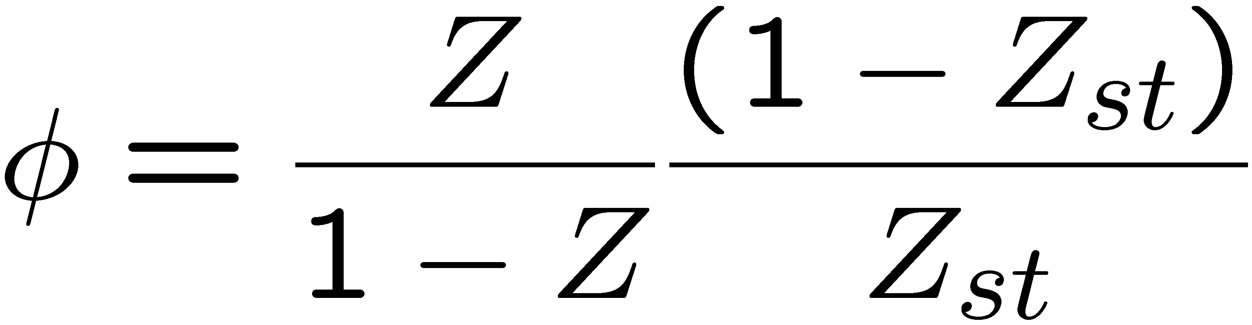
The fuel-air equivalence ratio is the ratio of fuel-air ratio in the unburnt to that of a stoichiometric mixture
Introducing and
into
leads with
to a unique relation between the equivalence ratio and the mixture fraction
2.-25

Slide 26
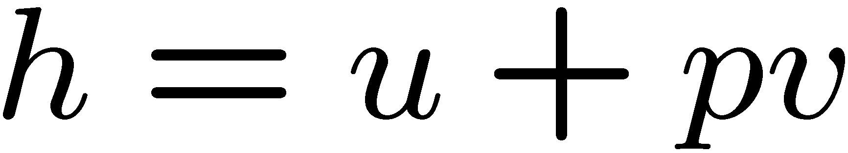
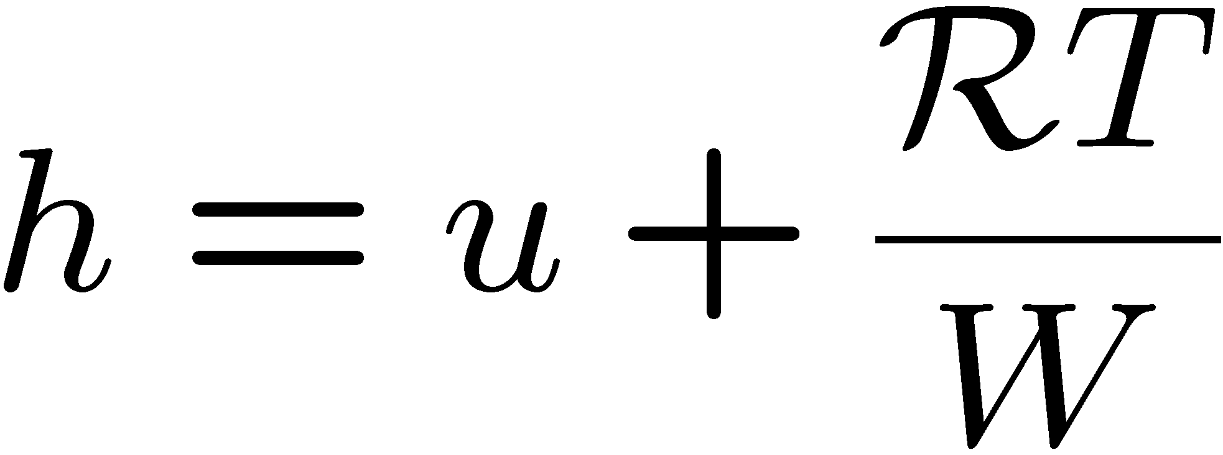
First law of thermodynamics - balance between different forms of energy
change of specific internal energy: du
specific work due to volumetric changes: δw^{rev}=pdv , v=1/ρ
specific heat transfer from the surroundings: δq
specific frictional work: δw_{R} ^{*)}
Related quantities
specific enthalpy (general definition):
specific enthalpy for an ideal gas:
Energy balance:
^{*)} The list of energies is not exhaustive, f. e. work of forces and kinetic or potential energies
are missing, but the most important which will appear in a balance are considered here.
2.-26

Slide 27
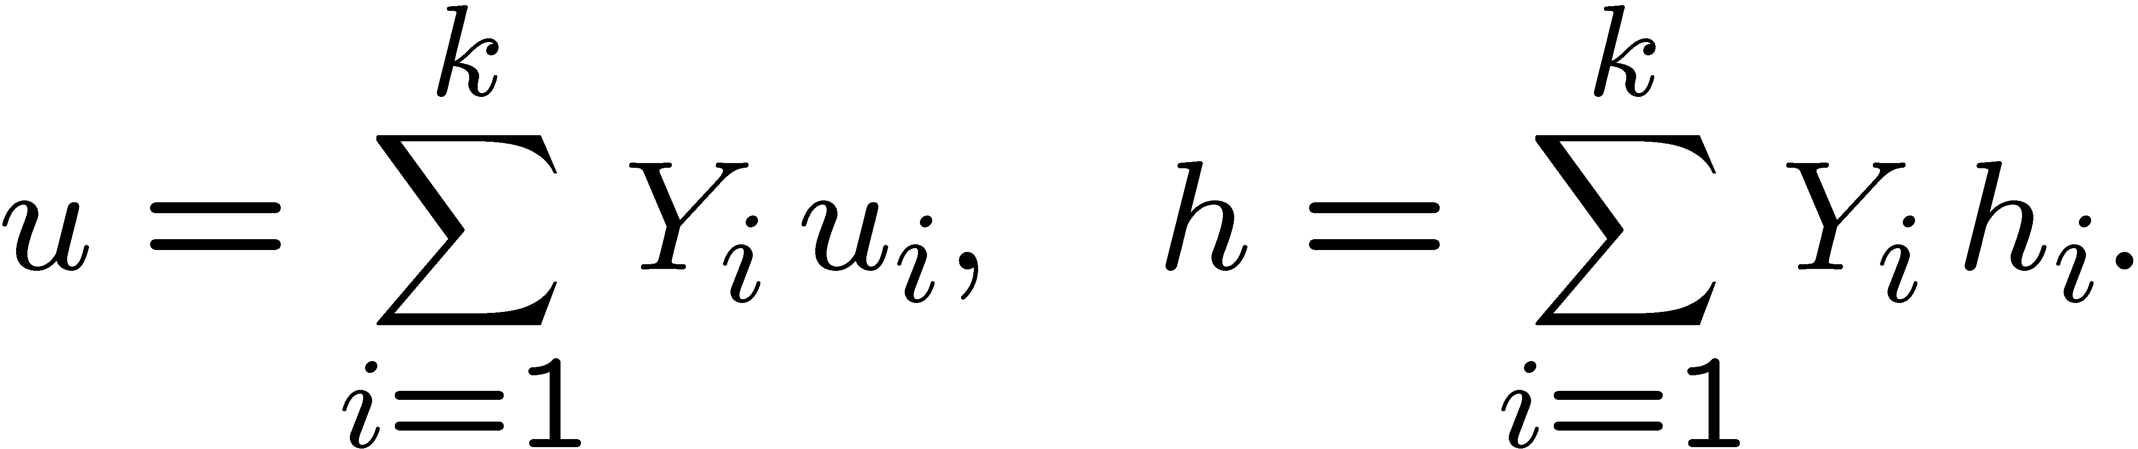
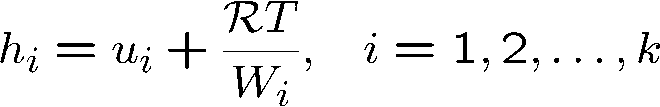
Multicomponent system
The specific internal energy and specific enthalpy are the mass weighted sums of the specific quantities of all species
For an ideal gas the partial specific enthalpy is related to the partial specific internal energy by
2.-27

Slide 28
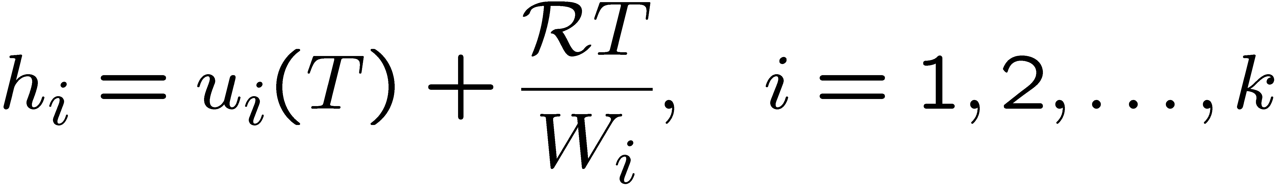
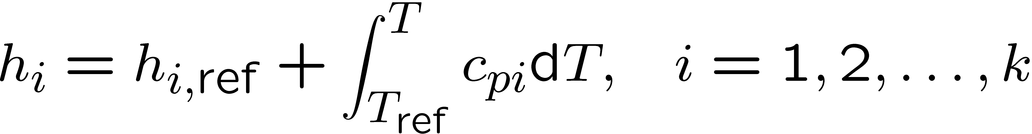
For an ideal gas the inner energy and enthalpy depend on temperature alone.
If c_{pi} is the specific heat capacity at constant pressure and h_{i,ref} is the reference enthalpy at the reference temperature T_{ref} ,
the temperature dependence of the partial specific enthalpy is given by
The reference temperature may be arbitrarily chosen, most frequently used:
T_{ref} = 0 K or T_{ref} = 298.15 K
2. -28

Slide 29
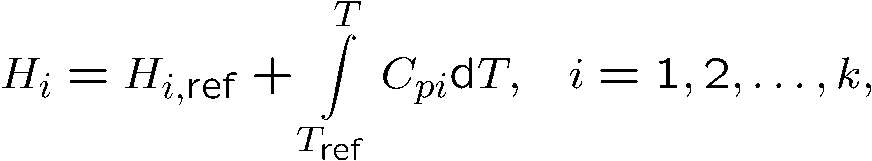
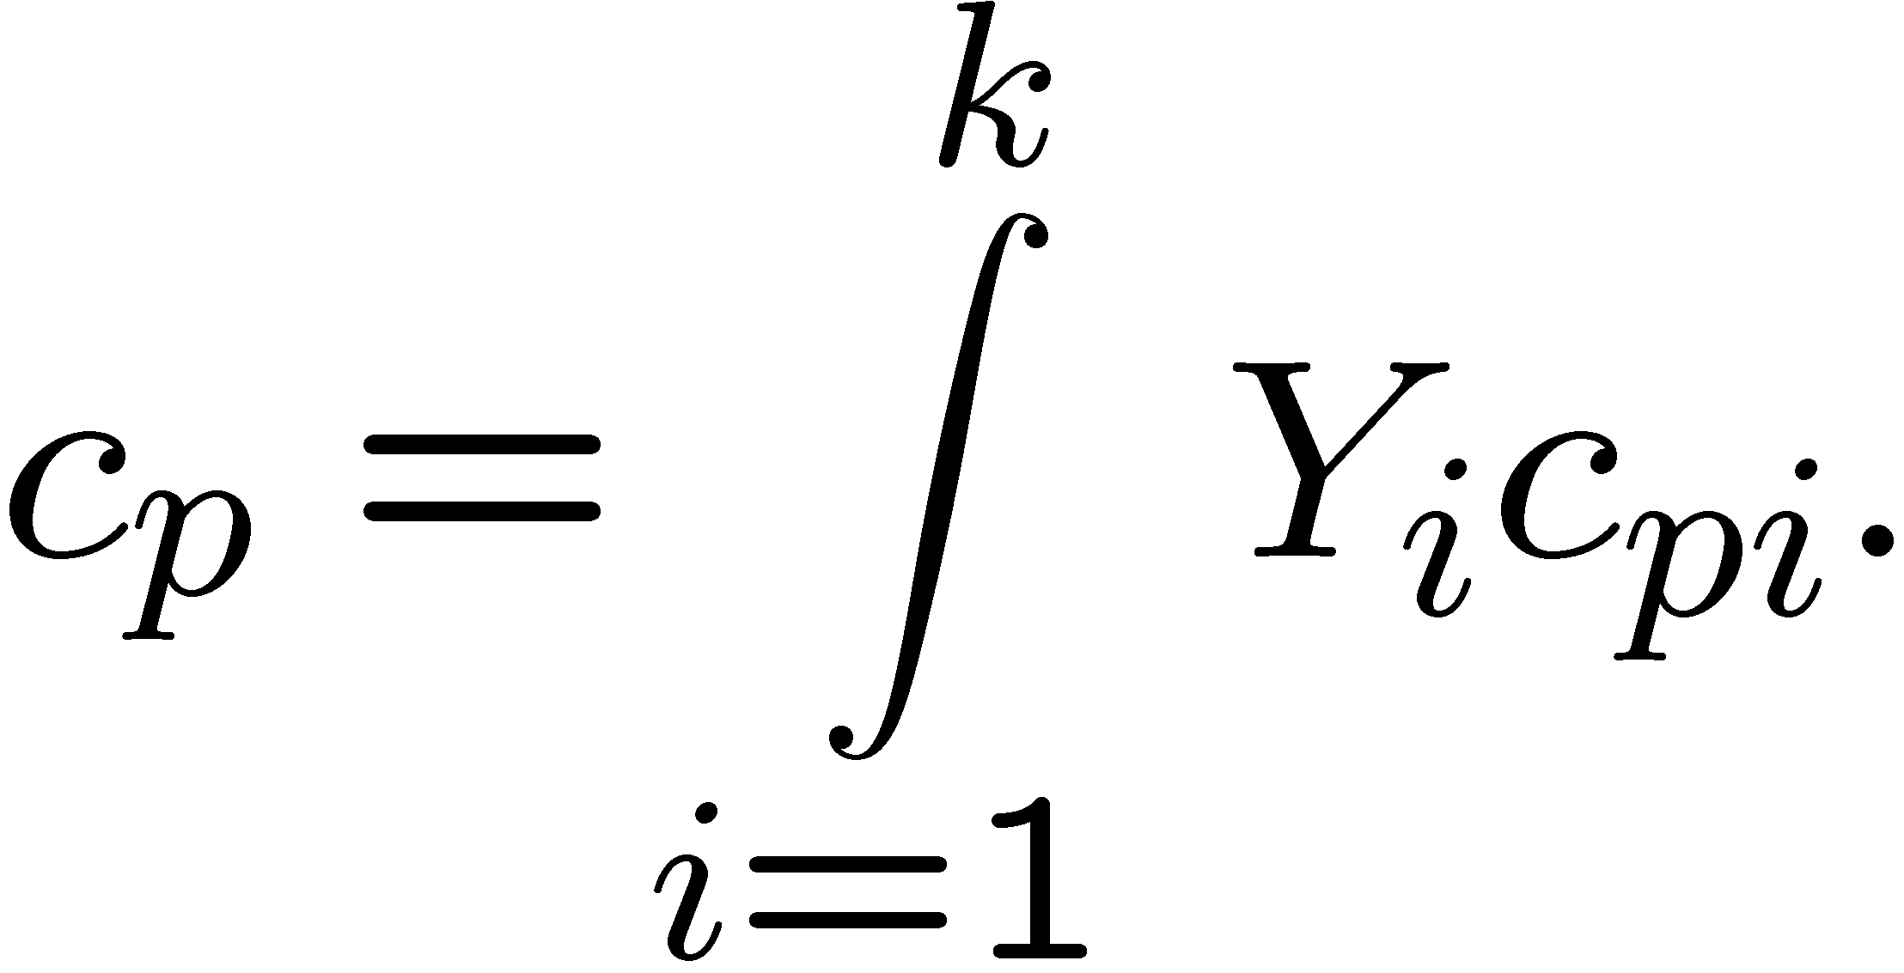
The partial molar enthalpy is
and its temperature dependence is
where the molar heat capacity at constant pressure is
In a multicomponent system, the specific heat capacity at constant pressure of the mixture is
2.-29

Slide 30
The molar reference enthalpies at reference temperature of species are
listed in tables.
It should be noted that the reference enthalpies of H₂, O₂, N₂ and solid carbon C_{s}
were chosen as zero, because they represent the chemical elements.
Reference enthalpies of combustion products such as CO₂ and H₂O are typically negative.
2. -30

Slide 31
The temperature dependence of molar enthalpy, molar entropy and molar heat capacities may be calculated from the NASA polynomials.
The constants a_{j} for each species i are listed in tables.
2.- 31

Slide 32
NASA Polynomials for two temperature ranges and standard pressure p = 1 atm
2.- 32

Slide 33




First law of thermodynamics for an adiabatic system at constant pressure
(δq = 0, dp = 0)
we neglect the work done by friction (δw_{R} = 0).
From
we then have:
Integrated from the unburnt, index u, to the burnt state, index b, it follows:
or
2.-33

Slide 34



With the temperature dependence of the specific enthalpy
this may be written as
Here the specific heat capacities are those of the mixture, to be calculated with the mass fractions of the burnt and unburnt gases
2.- 34

Slide 35



For a one-step global reaction the left hand side of
may be calculated by integrating
which gives
such that
2.- 35

Slide 36


Definition: heat of combustion
The heat of combustion changes very little with temperature.
It is often set equal to:
Simplification: T_{u} = T_{ref} and assume c_{p,b} approximately constant
For combustion in air, the contribution of nitrogen is dominant in calculating c_{p,b}.
2.- 36

Slide 37


The value of c_{pi} is somewhat larger for CO₂ and somewhat smaller for O₂ while that for H₂O is twice as large.
A first approximation for the specific heat of the burnt gas for
lean and stoichiometric mixtures:
c_{p} = 1.40 kJ/kg/K
Assuming c_{p} constant and Q = Q_{ref} , the adiabatic flame temperature for a lean mixture (Y_{F,b} = 0) is calculated from
and
with ν_{F} = - ν'_{F} as
2.- 37

Slide 38


For a rich mixture
must be replaced by
One obtains similarly for complete consumption of the oxygen (Y_{O2,b} = 0)
2.- 38

Slide 39
Equations and
may be expressed in terms of the mixture fraction.
Introducing and
and specifying the temperature of the unburnt mixture by
where T₂ is the temperature of the oxidizer stream and T₁ that of the fuel stream.
This equation describes mixing of the two streams with c_{p} assumed to be constant.
2.- 39

Slide 40


Equations and
then take the form
The maximum temperature appears at Z = Z_{st} :
2.- 40

Slide 41

2.- 41

